Slide 1

SATHYABAMA INSTITUTE OF SCIENCE AND TECHNOLOGY
DEPARTMENT OF COMPUTER SCIENCE AND ENGINEERING
PROFESSIONAL TRAINING -2-
Project Supervisor: Dr.T.Judgi M.E.,Ph.D.
NAME:VUYYURU PRANITHA REDDY
REG NO:40111455

Slide 2
Presentation Outline
Course Certificate
Introduction
Objectives
System Architecture / Ideation Map
Module Implementation
Application Snapshots
Results and Discussions
Conclusion & Future work
References

Slide 3
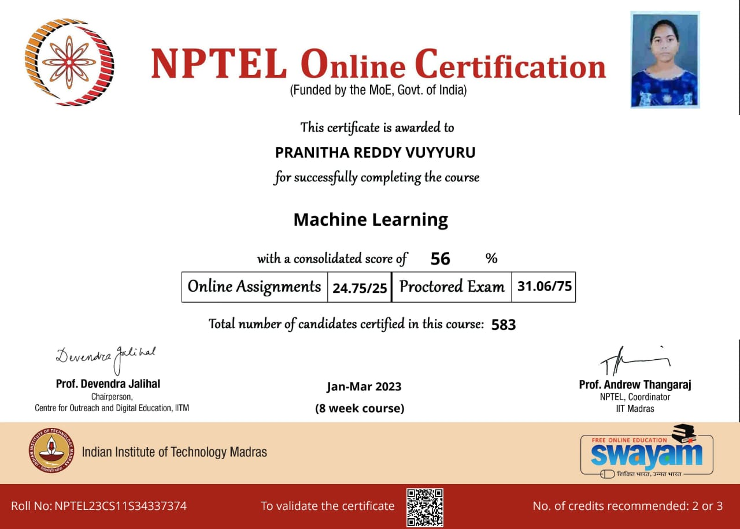

Slide 4
Introduction
The bank marketing is a specialized field of the marketing which has emerged following the extensive development of the general marketing and following the appearance, separation and development of services marketing.
This project is about to predict the values in the given dataset(bank marketing) using machine learning
To predict the y values in the given bank marketing dataset using features in the given dataset
For finding the solution we used logistic regression

Slide 5
Objectives
The objective of this project is to get y values and better accuracy.
The given dataset contains various attributes, dataset characteristics, attributes characteristics.
In machine learning we used classification method,logistic regression algorithm to achieve.

Slide 6
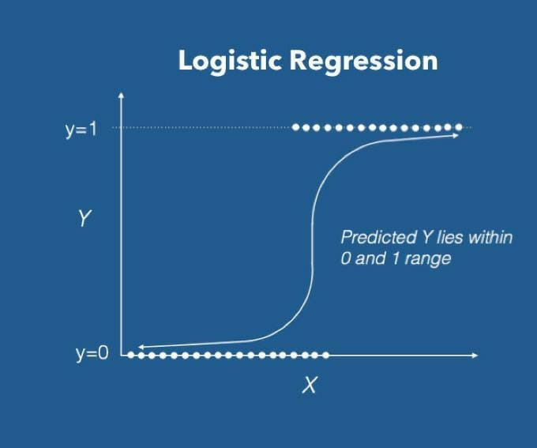
System Architecture / Ideation Map

Slide 7
System Architecture / Ideation Map
Collection of data set
Importing the libraries
Cleaning the data
Understanding the target variables
Data visualization
Fitting the logistic regression model
Checking model accuracy &printing pred values

Slide 8
Project Implementation
Module-In Python, Modules are simply files with the “py” extension containing Python code that can be imported inside another Python Program.
Modules we used in implementing this project- Numpy, pandas, matplotlib, pyplot , seaborn, sklearn etc.
Importation of modules-
import numpy as np
import pandas as pd
import matplotlib.pyplot as plt
import seaborn as sns , etc

Slide 9
Project Implementation
Hardware requirements
CPU: 2 x 64-bit 2.8 GHz 8.00 GT/s CPUs
RAM: 32 GB (or 16 GB of 1600 MHz DDR3 RAM)
Storage: 300 GB. (600 GB for air-gapped deployments.) Additional space recommended if the repository will be used to store packages built by the customer. With an empty repository, a base install requires 2 GB.Internet access to download the files from Anaconda.org or a USB drive containing all of the files you need with alternate instructions for air gapped installations.

Slide 10
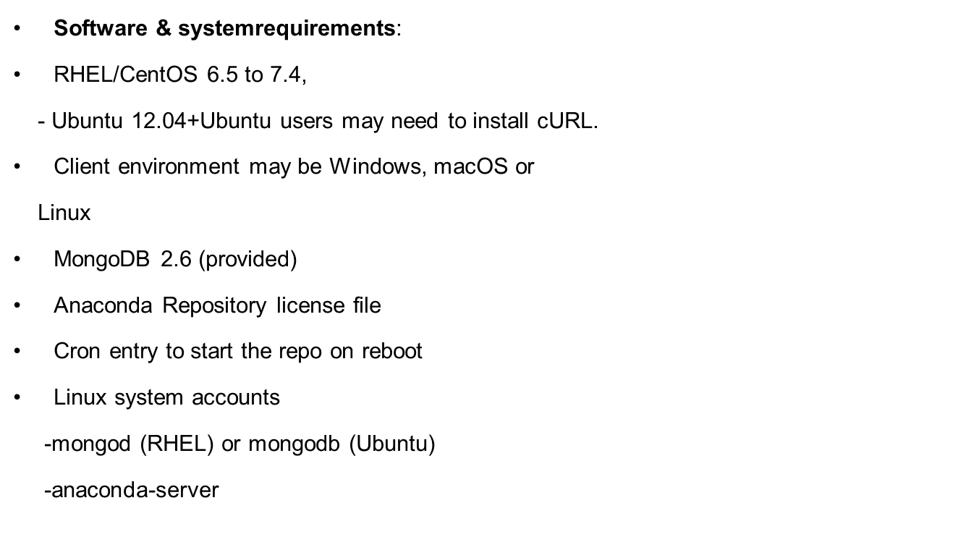
Project Implementation

Slide 11
Project Implementation
Construction :
Problem statement
Importing the libraries
Loading the dataset
Data Insights
Summary Statistics
Understanding the target variable
Data visualization
Fitting a logistic regression Model
Checking model accuracy

Slide 12
Project Implementation
Interpretation of result:
On the test data , the best AUC score achieved was 0.8839. The importance of the features (in terms of how greatly they affected the coefficients) was also plotted. This provides valuable insight toward understanding which features contribute the most toward the models’ performance.

Slide 13
Methodology
In machine learning we used classification method,logistic regression algorithm.
Technology : Jupyter is a free, open-source, interactive web tool known as a computational notebook, which researchers can use to combine software code, computational output, explanatory text and multimedia resources in a single document.
Software tools:
-Machine learning
-python3
By using above technology, software tools we are going to achieve our objective.

Slide 14
Methodology
Logistic regression algorithm:
Logistic regression is one of the most popular Machine Learning algorithms, which comes under the Supervised Learning technique. It is used for predicting the categorical dependent variable using a given set of independent variables.
Logistic regression predicts the output of a categorical dependent variable. Therefore the outcome must be a categorical or discrete value. It can be either Yes or No, 0 or 1, true or False, etc. but instead of giving the exact value as 0 and 1, it gives the probabilistic values which lie between 0 and 1.
Logistic Regression is much similar to the Linear Regression except that how they are used. Linear Regression is used for solving Regression problems, whereas Logistic regression is used for solving the classification problems.

Slide 15


Methodology
Logistic regression equation:

Slide 16

Methodology
Steps in Logistic Regression:
To implement the Logistic Regression using Python, we will use the same steps as we have done in previous topics of Regression. Below are the steps:
1.Data Pre-processing step
2.Fitting Logistic Regression to the Training set
3.Predicting the test result
4.Test accuracy of the result(Creation of Confusion matrix)
5.Visualizing the test set result.

Slide 17
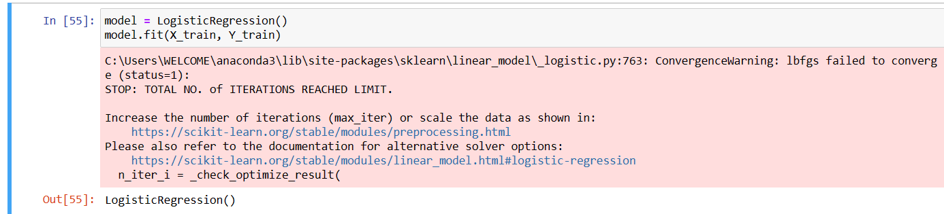
Snapshots

Slide 18
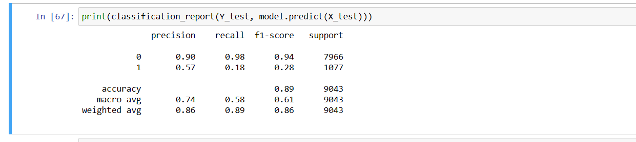
Snapshots

Slide 19
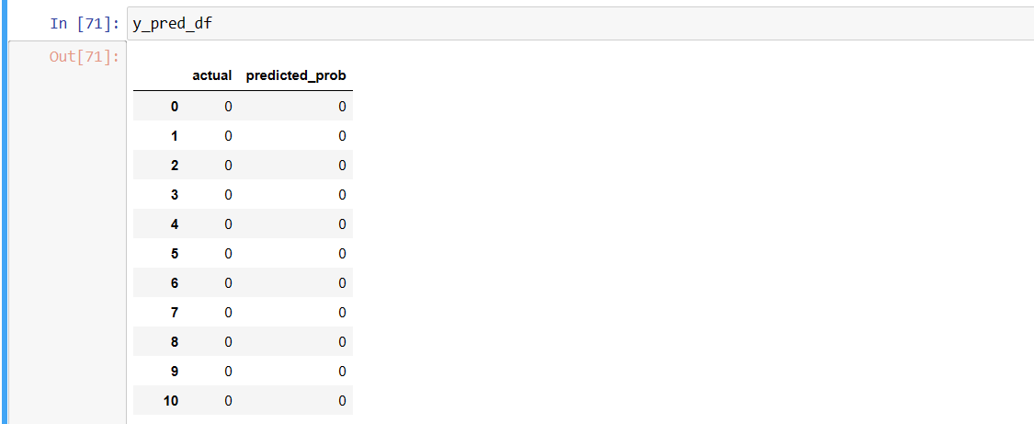
Results and Discussion

Slide 20
Results and Discussion
From the feature importance plot, it can be inferred that , age of the applicant, job, marital status ,education details, balance ,contact number, housing, loan, duration, pdays, poutcome are some of the most important features in predicting the outcome(y).

Slide 21
Conclusion
From this project, we learned how banks can improve their marketing campaigns by focusing their efforts on certain prime-grade clients and also how they can recognize market conditions which are favorable to increase client subscription for the fixed-term products they are offering.
We achieved our objective successfully by getting 88% accuracy and y predicted values in our project.

Slide 22
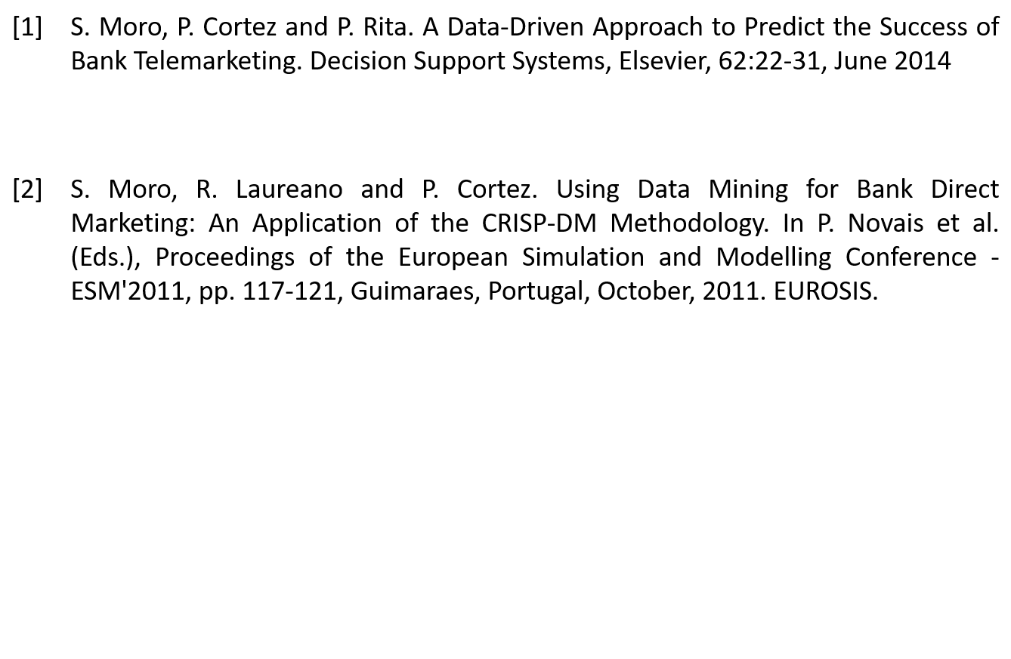
References

Slide 23


